Slide 1
Artificial Intelligence Methods (AE2AIM)
Lec. 03: Metaheuristics
Dr. Xinan Chen(Room IAMET308)
School of Computer Science
The University of Nottingham Ningbo, China
Email: Xinan.Chen@nottingham.edu.cn

Slide 2
Previous lecture
Methods for combinatorial problem
LP + rounding (Integer)
Greedy heuristics - constructive
Local Search (hill climbing) – iterative

Slide 3
In this lecture
Metaheuristics
Definition
Simulated annealing
Tabu Search

Slide 4
Local Search for Knapsack Problem
Data structures
struct item{
int indx;
int p;
int v;
double ratio;
};
struct problem{
int C; //knapsack capacity
int num_of_items;
item* items;
};
struct solution{
int objective;
int cap_left;
struct problem* prob;
int* x;
};
int main()
{
problem* prob = loaddata("knapsack.txt");
solution init_sln=initialise_sol();
print_sol(init_sln);
solution *new_sln;
solution *curt_sln = new solution();
curt_sln->copy_from(init_sln);
for(int k=0; k< NUM_OF_ITERS; k++)
{
new_sln=first_descent(*curt_sln);
if(new_sln)
{
curt_sln->copy_from(*new_sln);
new_sln->free_memoy();
}
}
print_sol(*curt_sln);
//free memory for all pointers
return 0;
}
Notes:
When designing algorithms, it is extremely important to have appropriate data structures.

Slide 5
First Descent Local Search
solution* first_descent(solution &sln)
{//using pair-swaps
int item1, item2;
solution* new_sln = new solution();
new_sln->copy_from(sln);
for(int i=0; i<NUM_OF_ITEMS; i++)
{
if(sln.x[i]>0)
{
item1 =i;
for(int j=0; j<NUM_OF_ITEMS; j++){
if(i!=j && sln.x[j]==0 &&
sln.cap_left + v[item1]>v[j])
{
item2=j;
new_sln->x[item1]= 0;
new_sln->x[item2]= 1; //swap
int delta =p[item2] - p[item1];
if(delta >0)
{
new_sln->objective =
sln.objective + delta ;
new_sln->cap_left =
new_sln->cap_left +
v[item1]-v[item2];
return new_sln;
}
else //restore
{
new_sln->x[item1] = 1;
new_sln->x[item2]=0;
}//endelse
}//endif
}//endfor
}//endif
}//endfor
return NULL;
}
Notes:
Can you work out the code for best descent local search?

Slide 6
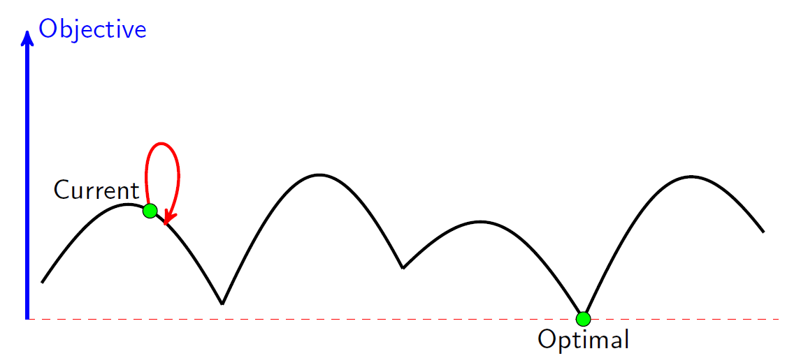
Drawbacks of Hill Climbing
Local Optimum: If all neighboring states are worse or the same. The algorithm will halt even though the solution may be far from satisfactory.
Plateau (neutral space/shoulder): All neighboring states are the same as the current state. In other words the evaluation function is essentially flat. The search will conduct a random walk.
exploitation
exploration

Slide 7
Meta-heuristics
Metaheuristics are solution methods that orchestrate an interaction between local improvement procedures and higher level strategies to create a process capable of escaping from local optima and performing a robust search of a solution space”
Glover and Kochenberger 2003. Handbook of Metaheuristics, Kluwer.

Slide 8
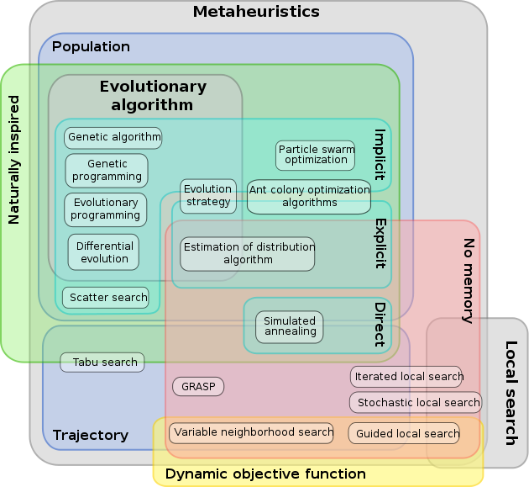
Metaheuristics Family

Slide 9
Simulated Annealing

Slide 10
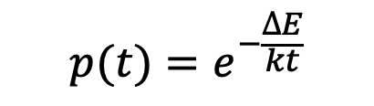
Metal Material Annealing
Annealing is a heat treatment to improve mental properties between ductility and hardness.
To reform new strain-free, uniformed structures.
Particle move from low energy state to high energy state is governed by Metropolis probability (where k is a constant known as Boltzmann constant):
$$p(t)=e^{−\frac{∆E}{kt}}$$
Before annealing
Heating
After annealing
Notes:
Steel industry is a pillar industry in any big country.

Slide 11
Simulated Annealing
Motivated by the physical annealing process
Material is heated and slowly cooled into a uniform structure.
Simulated annealing mimics this process
The first SA algorithm was developed in 1953 (Metropolis).
Kirkpatrick (1982) applied SA to optimisation problems
Kirkpatrick, S , Gelatt, C.D., Vecchi, M.P. 1983. Optimization by Simulated Annealing. Science, vol 220, No. 4598, pp 671-680. [cited 43109 times].

Slide 12
Simulated Annealing Analogy
Mental Annealing | Simulated Annealing
Particles | Solutions
Engery function | Objective function
Particle moves between different engery states | Search process
Lowest energy state | Optimal solution
Temperature | Temperature

Slide 13
SA v.s. Local Search
Local Search
SA
if(delta >0)
{
new_sln->objective =
sln.objective + delta ;
new_sln->cap_left =
new_sln->cap_left +
v[item1]-v[item2];
return new_sln;
}
else //restore
{
new_sln->x[item1] = 1;
new_sln->x[item2]=0;
}//endelse
}//endif
}//endfor
}//endif
}//endfor
return NULL;
}
Compared to hill climbing the main difference is that SA allows downwards steps
Simulated annealing also differs from hill climbing in that a move is selected at random and then decides whether to accept it
In SA better moves are always accepted. Worse moves are not.

Slide 14
SA Algorithm (for minimizing)
Create an initial solution s₀ (often by a greedy heuristic);
Set parameters: starting temperature: t_{s}; stopping temperature: t_{f.} , and a cooling schedule: t = s(t), set current solution s=s₀ and number of repetitions at each temperature, nrep. Define neighbourhood N(s)
while (t>t_{f} && n < K)
while(rep< nrep)
s’=random(N(s)); rep++; r=random(0,1);
δ=f(s’)-f(s);
if (δ <0 || p = exp(-δ /t)> r) set s=s’; endif
update the best solution found so far, s*
endwhile
Update temperature t=s(t). n++; rep=0;
endwhile
return s*

Slide 15
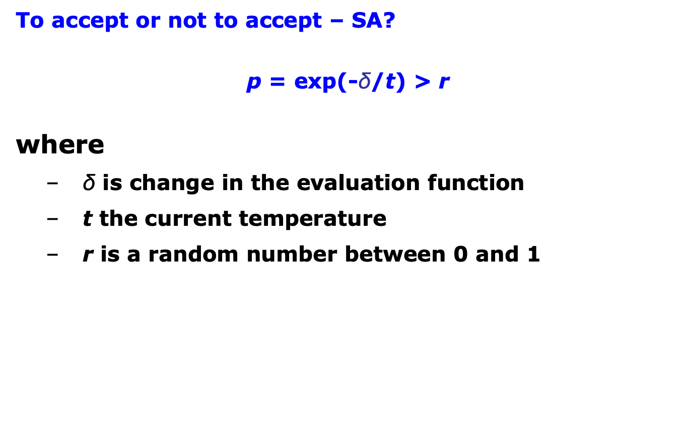
Simulated Annealing
To accept or not to accept – SA?
p = exp(-$\text{δ}$/t) > r
where
δ is change in the evaluation function
t the current temperature
r is a random number between 0 and 1

Slide 16
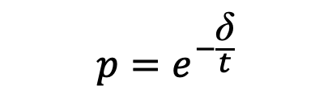
Simulated Annealing
To accept or not to accept – SA?
The probability of accepting a worse state is a function of both the temperature of the system and the change in the evaluation function.
Small increase in evaluation function is more likely accepted than a large jump.
As the temperature decreases, the probability of accepting worse moves decreases.
If t=0, no worse moves are accepted (i.e. hill climbing)
When t is sufficiently high, all moves are accepted (random walk)
$$p=e^{−\frac{\text{δ}}{t}}$$

Slide 17
SA Cooling Schedule
Starting Temperature t_{s}
Final Temperature t_{f}
Temperature Decrement s(t)
Iterations at each temperature nrep

Slide 18
SA Cooling Schedule
Starting Temperature
Must be hot enough to allow moves to almost all neighbourhood states (else we are in danger of implementing hill climbing)
Must not be so hot that we conduct a random search for a period of time
Problem is finding a suitable starting temperature is problem-dependent

Slide 19
SA Cooling Schedule
Starting Temperature
If we know the maximum change in the cost function we can use this to estimate
Start high, reduce quickly until about x% of worse moves are accepted. Use this as the starting temperature
Heat rapidly until a certain percentage are accepted the start cooling

Slide 20
SA Cooling Schedule
Final Temperature
It is usual to let the temperature decrease until it reaches zero However, this can make the algorithm run for a lot longer, especially when a geometric cooling schedule is being used
In practise, it is not necessary to let the temperature reach zero because the chances of accepting a worse move are almost the same as the temperature being equal to zero
Therefore, the stopping criteria can either be a suitably low temperature or when the system is “frozen” at the current temperature (i.e. no better or worse moves are being accepted)

Slide 21
SA Cooling Schedule
Temperature cooling functions
Theory states that we should allow enough iterations at each temperature so that the system stabilises at that temperature – Markov process
Unfortunately, theory also states that the number of iterations at each temperature to achieve this might be exponential to the problem size
Two common functions
Geometric t=at
Non-linear t = t/(1 + βt)
Others …

Slide 22
SA Cooling Schedule - nrep
Iterations at each temperature
An alternative is to dynamically change the number of iterations as the algorithm progresses
At lower temperatures it is important that a large number of iterations are done so that the local optimum can be fully explored
At higher temperatures, the number of iterations can be less

Slide 23
SA Modifications - Cooling
If you plot a typical cooling schedule you are likely to find that at high temperatures many solutions are accepted
If you start at too high a temperature a random search is emulated and until the temperature cools sufficiently any solution can be reached and could have been used as a starting position

Slide 24
SA Modifications - Cooling
At lower temperatures, a plot of the cooling schedule, is likely to show that very few worse moves are accepted; almost making simulated annealing emulate hill climbing

Slide 25
SA Modifications - Cooling
Taking this one stage further, we can say that simulated annealing does most of its work during the middle stages of the cooling schedule
(Connolly, 1990) suggested annealing at a constant temperature

Slide 26
SA Modifications - Cooling
But what temperature?
It must be high enough to allow movement but not so low that the system is frozen
But, the optimum temperature will vary from one type of problem to another and also from one instance of a problem to another instance of the same problem

Slide 27
SA Modifications - Cooling
One solution to this problem is to spend some time searching for the optimum temperature and than stay at that temperature for the remainder of the algorithm
The final temperature is chosen as the temperature that returns the best cost function during the search phase

Slide 28
SA Modifications - Reheating
Sometimes when cooling parameters are not set properly, SA may converge to poor local optima and cannot escape.
One strategy is to reheat the system by increase the temperature.
Several ways to set the new temperature
Incremental increase
Increase your temperature to a value where most improving solutions were found previously.
Increase to a level with a specific acceptance ratio.

Slide 29
SA Modifications – Multiple Neighbourhoods
The neighbourhood of any move is normally the same throughout the algorithm but…
The neighbourhood could be changed as the algorithm progresses
For example, a cost function based on penalty values can be used to restrict the neighbourhood if the weights associated with the penalties are adjusted as the algorithm progresses

Slide 30

SA Playground
Copy the code from the Moddle
https://moodle.nottingham.ac.uk/pluginfile.php/10867793/mod_folder/content/0/lec03-testcode.py
Run it on your PC or through the website:
https://www.online-python.com/
Try to find better parameters (Cost lower than: 20272.21)
Share your performance in Menti
Compare with classmates and share your parameter tuning, which parameter is most important?
Keep your running record

Slide 31
Exploitation vs. Exploration in SA
Exploitation: cooling the temperature
Exploration: heating up the temperature
p = e^{-[f (s’) – f (s)] / t}
Cycles!!!
SA is a memoryless method and may be not capable to prevent cycles if temperature is not set appropriately.

Slide 32
Next lecture
Metaheuristics II
Tabu Search
Variable Neighbourhood Search

